Slide 1
Secure Data Hiding in Image Using Steganography
CAPSTONE PROJECT
Presented By: Sharlene Anna Pereira
Student Name : Sharlene Anna Pereira
College Name & Department : CHRIST (Deemed To Be University),
Computer Science And Engineering

Slide 2
OUTLINE
Problem Statement
Technology used
Wow factor
End users
Result
Conclusion
Git-hub Link
Future scope

Slide 3
Problem Statement
Traditional encryption produces visible ciphertext, making it susceptible to interception.
Attackers can detect encrypted messages and attempt decryption.
This project hides AES-256 encrypted messages inside images using steganography.
The encrypted text remains invisible and undetectable to unauthorized users.
Even if extracted, the message cannot be read without the correct password.

Slide 4
Technology used
Programming Language
Python: Used for implementing encryption, image processing, and user interface.
Development Environment
Google Colab: A cloud-based platform for running Python scripts.
GitHub: Version control and project hosting.
Libraries Used
OpenCV: Image processing and manipulation.
Gradio: Creating a user-friendly interface for encryption and decryption.
Cryptography: Implementing AES-256 encryption and password-based key derivation.
NumPy: Handling numerical operations and image data processing.

Slide 5
Wow factors
AES-256 Encryption: The highest level of encryption used to secure sensitive data.
Steganography Integration: Hides encrypted messages inside images, making them invisible to unauthorized users.
Dual-Layer Security: Even if the image is extracted, the encrypted message remains protected with AES encryption.
Gradio Web Interface: Provides an interactive and easy-to-use interface for encryption and decryption.
Cross-Platform Compatibility: Works on any operating system that supports Python.
Small File Size Impact: The encryption and embedding process does not significantly alter the size or quality of the image.

Slide 6
End users
Individuals: Protect private messages from unauthorized access.
Organizations: Securely share sensitive business communications.
Journalists and Activists: Safeguard confidential information in high-risk environments.
Cybersecurity Professionals: Study encryption and steganography techniques.
Law Enforcement Agencies: Use steganography for undercover communications.

Slide 7
Results
Encryption Process
The user uploads an image and enters a secret message.
The message is encrypted using AES-256.
The encrypted text is embedded into the image pixels.
The modified image is saved, appearing unchanged to the naked eye.
Decryption Process
The encrypted image is uploaded back into the system.
The correct password must be provided for decryption.
The hidden encrypted message is extracted from the image.
The message is decrypted and displayed in its original form.

Slide 8
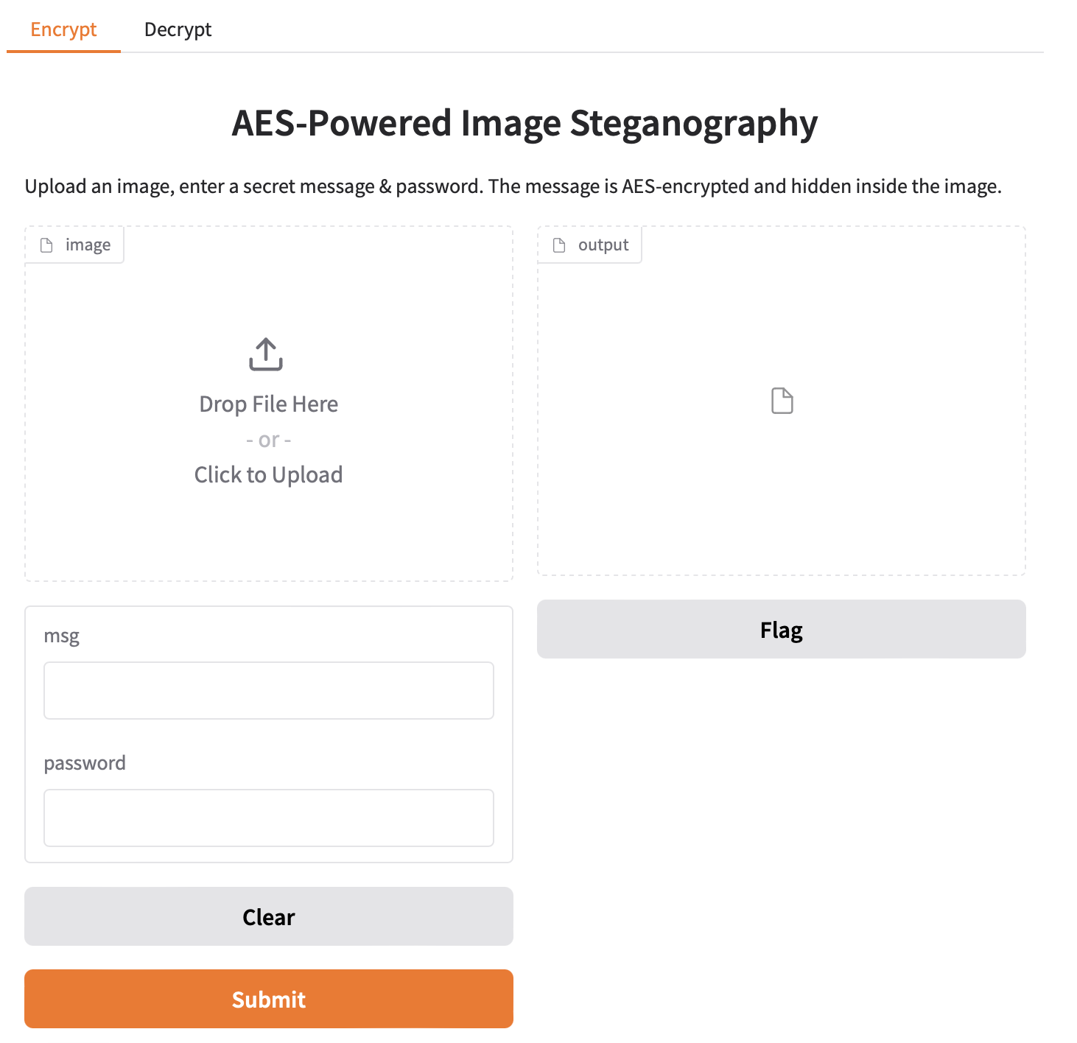
Results
Fig: AES-Powered Image Steganography Interface

Slide 9
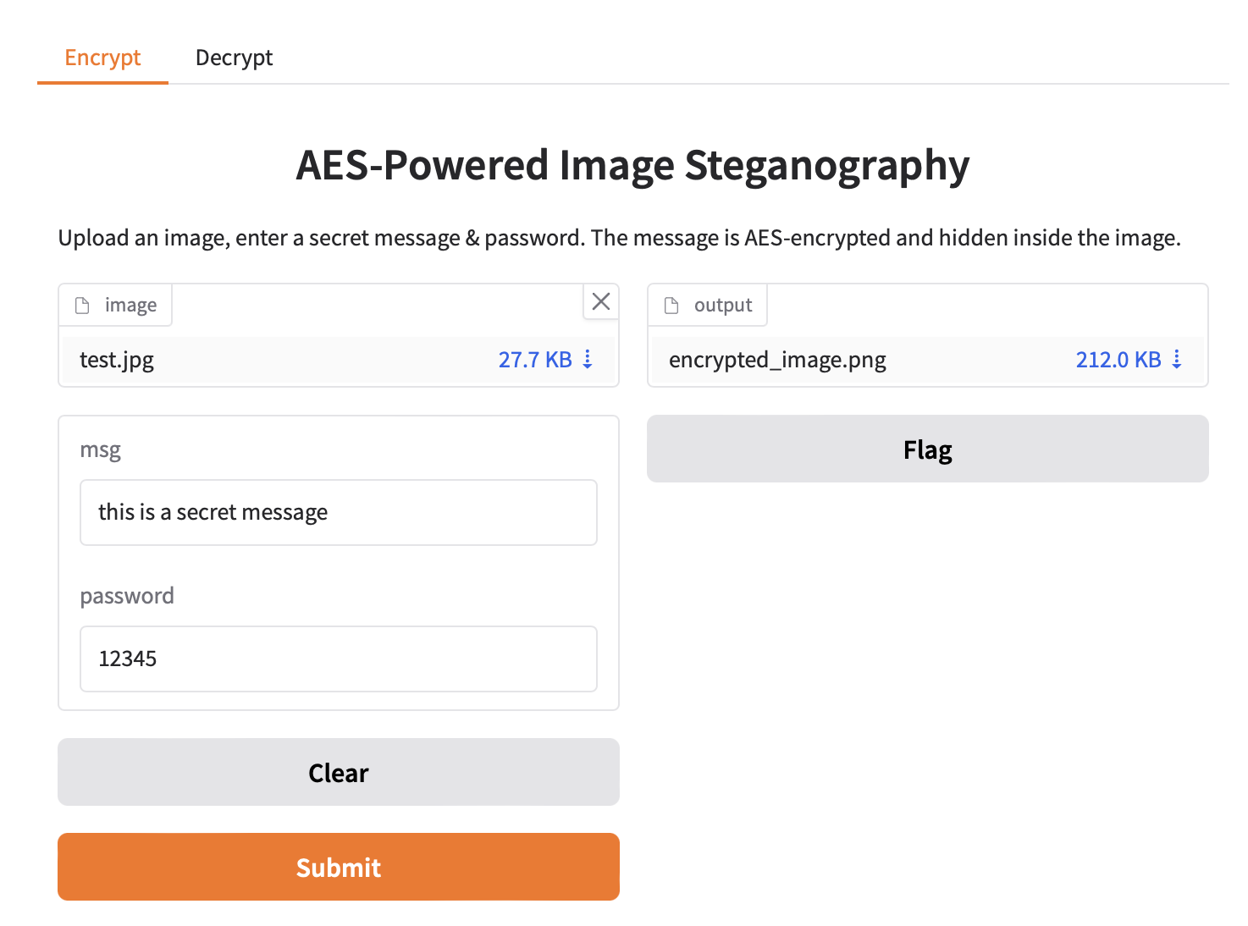
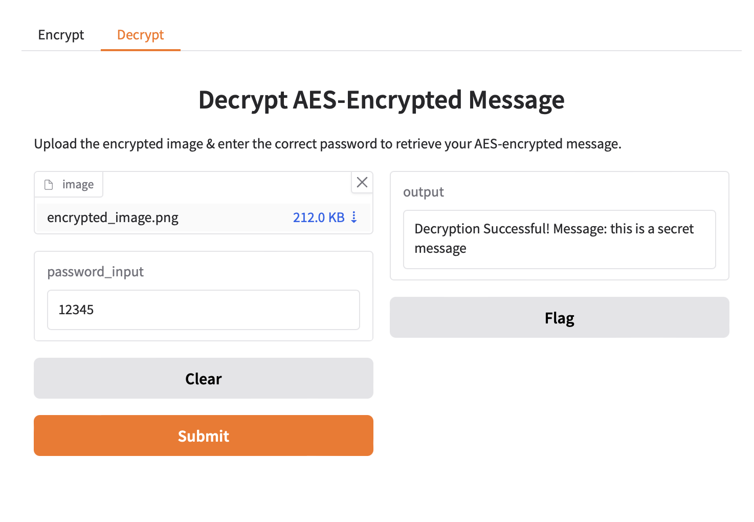
Results
Fig: Encryption Interface Fig: Decryption Interface
Designed to hide AES-encrypted messages inside images. Retrieves hidden messages using the correct password.

Slide 10
Conclusion
Project Achievements
Successfully combined AES-256 encryption with steganography for secure message hiding.
Developed a user-friendly interface using Gradio for accessibility.
Ensured messages remain undetectable and protected from attacks.
The project demonstrates a practical approach to secure communication.
Key Takeaways
Encryption alone is not enough—steganography adds an extra layer of security.
Even if the image is intercepted, the encrypted message remains unreadable without the correct password.
This technique can be applied to secure messaging, watermarking, and digital forensics.

Slide 11
GitHub Link
https://github.com/sharleneanna/Image-Steganography-AES.git

Slide 12
Future scope
Quantum-Secure Encryption: Implement post-quantum cryptography for even stronger security.
Video Steganography: Extend the project to hide encrypted messages inside video files.
AI-Powered Steganography: Use machine learning to optimize embedding techniques and improve resistance against detection.
Blockchain Integration: Store encrypted messages securely using decentralized technology.
Multi-Layer Steganography: Hide messages in multiple layers of an image for enhanced security.

Slide 13
THANK YOU

